Slide 1
Private Equity
in
Developing Countries
Present
By
小丸子 小新

Slide 2
WHY
HOW
WHAT
1
of

Slide 3
WHY
Private Equity
Developing Countries
China&India
1
2
3
Loading
2
of

Slide 4
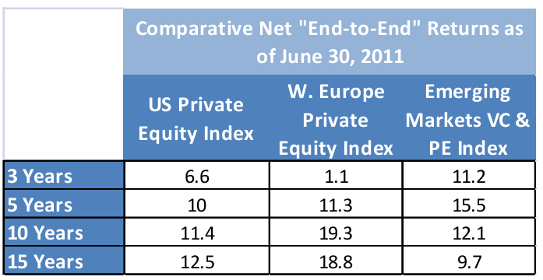
Why Private Equity
1
Attractive Return
Mitigate Risk
Exhibit 1
Business Uncertainty
Hard-to-value Assets
Info Asymmetries
3
of

Slide 5
Why Developing Countries
2
Exhibit 2
Higher growth
Lower leverage
High rate of job creation
Support for smaller company
“
Economic growth remains the primary driver of increasing emerging market private equity commitments.
Source: www.empea.net
”
4

Slide 6
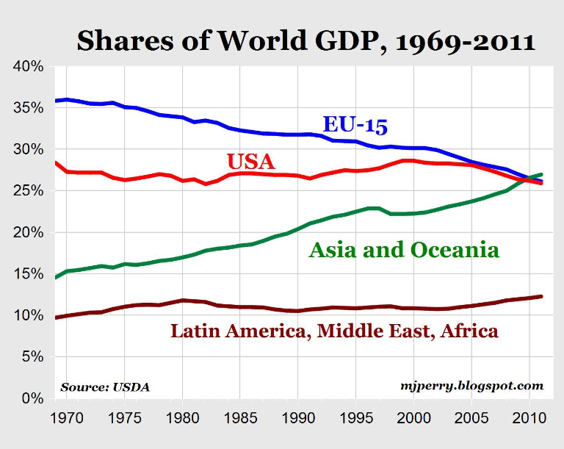
Why Developing Countries
2
EU
36%
26%
Asia/Oceania
27%
15%
Exhibit 3
For 2010 & 2011, Asia/Oceania's share is higher than both the EU15 and the USA
5

Slide 7
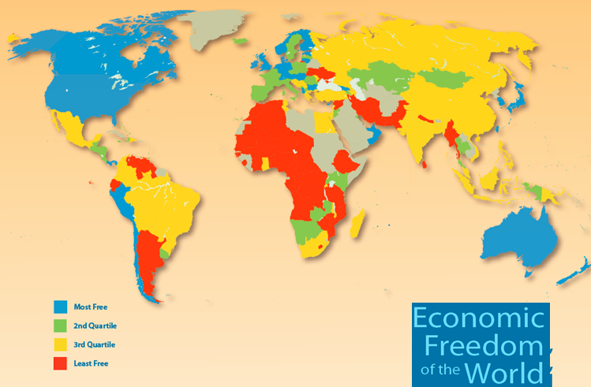
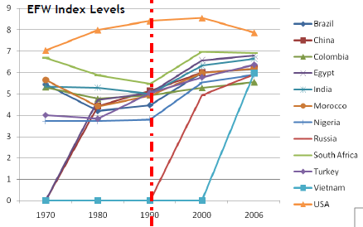
Why Developing Countries
2
Emerging markets increase
US one of countries that declined fastest
Exhibit 4 & 5
The index measures: size of gov, expenditures, taxes, enterprises, legal structure and security of property rights, access to sound money freedom to trade internationally regulation of credit, labor, and business
6

Slide 8
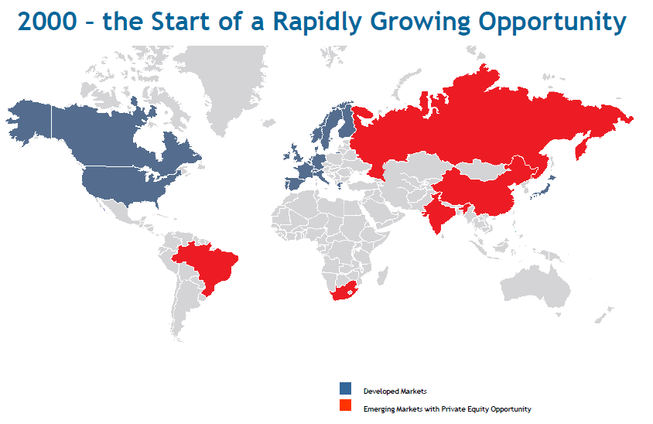
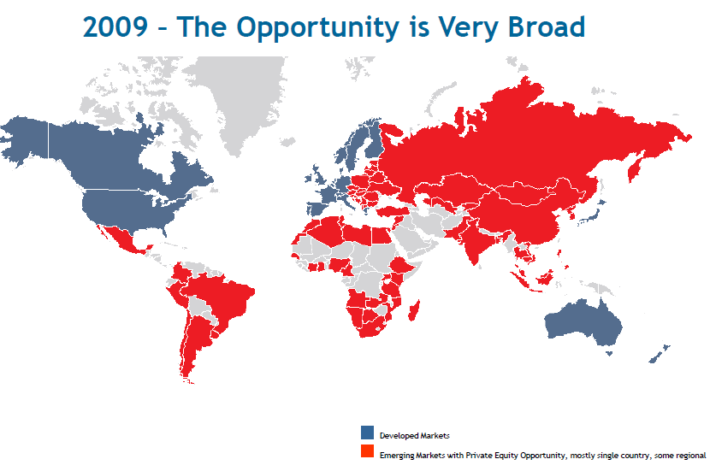
Why Developing Countries
2
Exhibit 6 & 7
Both the Breadth and the Quality of the Emerging Market Private Equity Opportunity have Improved Since 2000.
7

Slide 9
Why Developing Countries
2
1989 Brady Plan
Restructure external debt
Boost economic health
Increase investor confidence
Attractiveness of Developing Countries
Tax Reform
Lower tax on capital gains
Economic Progress
Economic Reform
Planned ➔ Capitalist
Relax Restriction of Foreign Investment
Encourage equity investment & stock market growth
Improve Accounting & Disclosure Standards
Lower investing costs
Diminish info asymmetries
8
of

Slide 10
Why China&India
3
Emerging Asian markets NO.1 attractive destinations for global investors
China No.1 investment target for 9 consecutive years
India No.2 investment target
Urban Migration
Rising Middle Class
Increasing Market Demand
10

Slide 11
Why China & India
3
1980s | Foreign direct investment allowed: 4 economic zones (1990 every city)
1990 | 1st stock exchange
2001 | Join WTO
2004 | 2nd board for SMEs—liquidity for 29.3m SMEs(contributes 75% workforce, 51% GDP
2004 | Legalized the ownership of private property gave corporation an infinite life
2006 | Bankruptcy law—framework of bankruptcy in private and state-owned enterprises, clear procedures for insolvent enterprise to restructure or exit allotment option on IPOs, one year lockup
11

Slide 12
HOW
Fundraising
Investing
Exiting
1
2
3
Loading
14

Slide 13
How Fundraising – Fund Structure
1
Limited liability partnership
Under the old Partnership Law, only unlimited liability partnerships were permissible.
Legal person partners
The amended Partnership Law allows both legal persons and individuals to invest in partnerships
19

Slide 14
How Fundraising – Capital Source
1
Institutional Investors
With the exception of investments targeted towards infrastructure, regulations don’t permit conventional sources of PE capital like insurance companies and pension funds in India to participate in PE.
Domestic PE firms are limited to raising fund from non-financial institutions.
Individual Investors
Domestic PE firms are limited to raising fund from affluent individual investors.
21

Slide 15
How Fundraising – Capital Source
1
New PE player in developing country
US foreign aid (eg., USAID), UN, World Bank, IIC, CDC
Gov. investment arm: EBRD, DEG, FMO, Norfund,
Quasi gov corp. (eg. OPIC)
Multilateral financial institutions (eg.IFC)
2 fold role
Invest in Funds as direct grant/LT loan
Provide guarantee
22

Slide 16
How Fundraising – Capital Source
1
Why Local Based Fund
language
local networks
experience at top US-based institution
“
For any of the large private-equity firms in the West to be a real player in China, you probably should have a RMB-dominated fund.
”
-- David Rubenstein
24

Slide 17
How Investing: Types of Investment
2
27

Slide 18
How Investing: Types of Investment
2
Privatizations
Improve the productivity of SOE (<< private firms)
Access investment capital &Improve service delivery
Reduce the fiscal burden of loss-making firms
29

Slide 19
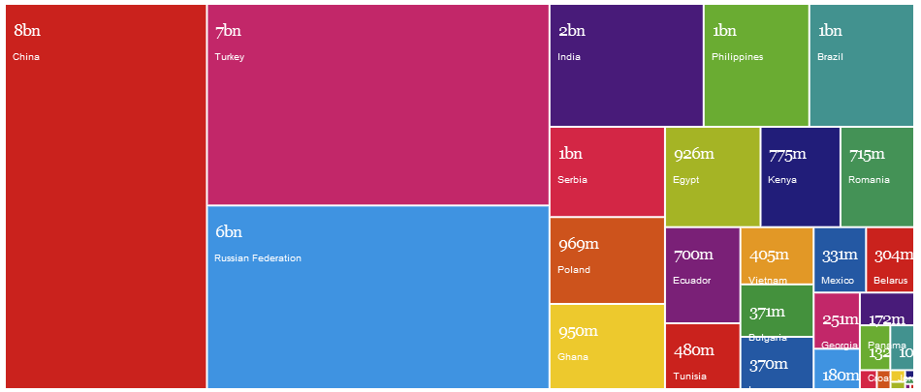
How Investing: Types of Investment
2
Privatizations-- Developing Countries
Exhibit 13
Privatization in developing countries.
30

Slide 20
How Investing: Types of Investment
2
Privatizations -- Post-Crisis Development
 | Crisis created pressures for privatization ⬅growing budget deficits ⬅ increased government spending and declining revenues India : mandatory for all profitable SOEs to offer >10% of shares Russian : an ambitious program to generate revenues.
 | A wave of nationalizations may happen. Truth: gov interventions mainly in developed countries, primarily as a temporary rescue, not a permanent takeover
 | The legal and institutional framework remains in place Regulatory and corporate governance reforms in response to the crisis
33

Slide 21
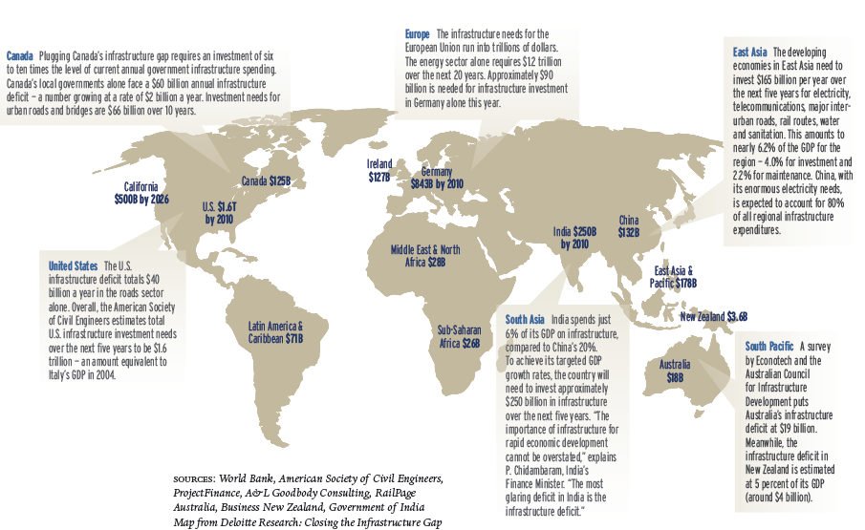
How Investing: Types of Investment
2
Infrastructure Funds : Macro Needs
Exhibit 16
Macro needs of infrastructure funds.
42

Slide 22
How Exiting
3
IPO | Strong link between health of IPO market and the fund raising ability of PE funds
M&A | Trade Sale or financial Investor
Share Sale
Other | Write-off, buy-back and put back to company or seller
Exhibit 17
Exit channels in China and India, 2000-2010
46

Slide 23
WHAT
Opportunities
Challenges
1
2
3
Loading
52

Slide 24
What Opportunities
1
China
India
Clean tech, e.g.: renewable resources, recycling and pollution-control equipment.
Conversations around water coolers are not about whether investments will earn returns, said Jolly, but rather about how large the returns will be.
A booming market
The Internet sector (esp. popular TMT and e-commerce)
54

Slide 25
Thank
You
Thank
You
58

Slide 26
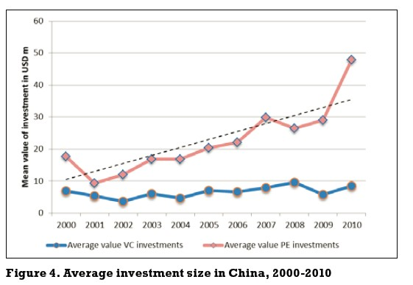
Appendix

Slide 27
PPT宝藏致力于优秀的ppt分享
PPT模板下载 http://www.pptbz.com/
PPT素材下载 http://www.pptbz.com/pptshucai/
PPT背景图片 http://www.pptbz.com/pptpic/
PPT课件下载 http://www.pptbz.com/kejian/
更多精美ppt下载请点击：ppt宝藏_www.pptbz.com

