Slide 1


GETTING
WEB READY
Introduction to Web Hosting

Slide 2

Table of Contents
+ Websites: The face of your business …………………………………………………………………………1
+ Get your website hosted………………………………………………………………………………………..4
+ Why get hosted?.....................................................................................................................................6
+ Types of hosting………………………………………………………………………………………………….7
› Shared Hosting
› VPS Hosting
› Dedicated Hosting
› Cloud Hosting
› Reseller Hosting
+ What to look for in a web host?................................................................................................................13
+ Conclusion…………………………………………………………………………………………………………23

Slide 3

WEBSITES
THE FACE OF YOUR BUSINESS
Small scale or large scale, the only way to establish a prominent online presence in the digital world and up your sales, is to have a website.
NOT HAVING A WEBSITE IS EQUAL TO
BECOMING EXTINCT IN THE ONLINE WORLD!
Here are a few benefits of having a website:
+ Establishing Business Identity.
+ Wider Business Reach.
+ Greater Lead Generation.
1

Slide 4

CONSIDERING
that there are far too many
platforms available to
help you create a website,
it isn’t really much of a task!
2

Slide 5

LET’S JUST SAY
You have a website in place... but you’re not creating as much impact online.
3

Slide 6
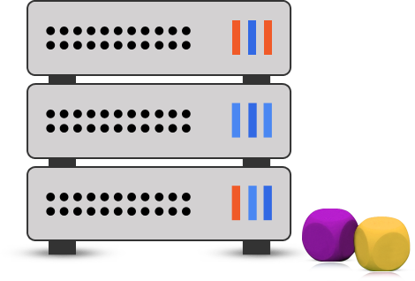
Break on through to the other side!
GET YOUR
WEBSITE HOSTED!
4

Slide 7

IF YOU WANT YOUR WEBSITE
To not only be easily accessible but also run efficiently
At all times, you need to publish along with a service provider.
Webhosting
User
User
User
User
Internet
server
Website files are hosted on servers. The servers 'serve' those files to individual computer users upon request. The internet makes it all possible.
5

Slide 8




WHY GET HOSTED?
Lesser
Bounce Offs.
Better Online
Presence!
More
Conversions.
6

Slide 9

BUT HOW DO I KNOW
which hosting plan fulfills my website needs?
Well, let’s take a look...
7

Slide 10
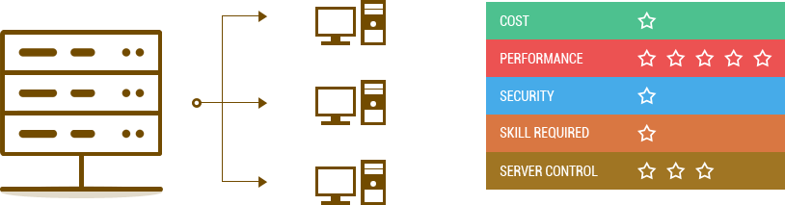
SHARED HOSTING
It is not only the most popular, but also the
most affordable web hosting plan. The web server is shared by multiple
websites in a common hosting environment. They share the same IP address and
server resources (disk space, RAM, bandwidth, uptime, etc).
8

Slide 11
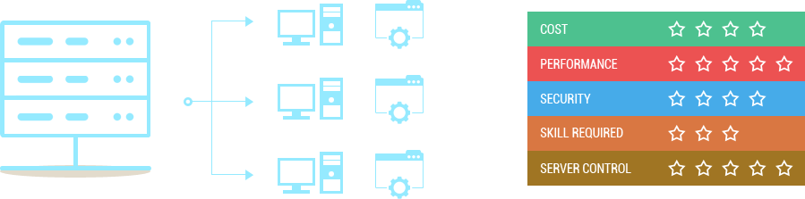
VPS HOSTING
In this hosting plan,
a server is divided into multiple virtual units
and each unit acts as a dedicated server that hosts only one website.
9

Slide 12

DEDICATED HOSTING
Here, the user rents the entire server to host his/her website.
The user can either choose to host one of his/her websites or all of them on that server. It
is best suited for websites that require higher server performance, security and control.
10

Slide 13

CLOUD HOSTING
This hosting service utilizes the trending cluster server technology.
A Cloud Hosted website is supported by a number of servers in the network.
The server resources are distributed amongst the websites on real time basis,
leading to proper configuration and load balancing.
11

Slide 14

RESELLER HOSTING
In this hosting plan,
a business rents a number of servers from a web host to offer web hosting services to a third party. In
other words, the business acts as the middleman offering hosting services of the parent host to
the end customer, and earning in the process.
12

Slide 15
BEING AWARE
Being aware of what’s available in the
market isn’t going to land you with a good
web hosting service provider. Asking is always
better than assuming!
Here are a few things you should ask your
prospective provider…
13

Slide 16

What’s Their Niche?
Every web host has one plan in which they are best at.
It may offer all plans, but its strength lies in that particular
plan.
Opt for a plan that fits your bill and a web host that is the
best at it.
14

Slide 17

DOES IT PROVIDE
ENOUGH DISK SPACE?
On an average, a website doesn’t need anything more than
1GB of disk space. Don’t fall for the ‘unlimited’ trap when
it comes to disk space.
Opt a web host that is transparent about their resource
allocation.
15

Slide 18

DO THEY HAVE 24/7
TECHNICAL SUPPORT?
A website has dozens of programs and extensions running
in the background; a technical glitch can arise anytime. To
ensure your website doesn’t break down and suffer bounce
offs, choose a web host that offers 24/7 prompt technical
support.
16

Slide 19

WHAT HARDWARE
ARE THEY USING?
Always enquire about the hardware being used by web
hosts to provide you services. Hardware has a direct
impact on the efficiency of your website. Don’t go for
hosts hesitant on giving out details.
17

Slide 20
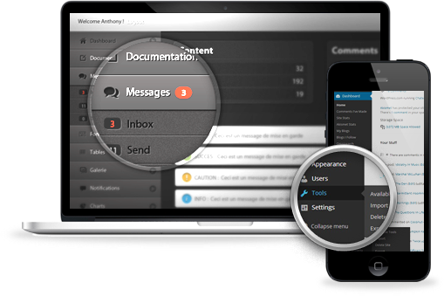
IS THEIR USER INTERFACE
FOR YOU?
Before you sign up for any hosting plan, go for a free trial
to test if the user interface and control panels fulfill your
needs; you don’t want to be switching hosts later.
18

Slide 21

DOES IT OFFER EMAIL?
Ensure that your web host offers emailing features
like smart inbox, autoresponders, etc. This helps you
make your website fully interactive.
19

Slide 22

WHAT’S THERE TO ADD?
With time your website is going to evolve and you might
want to have more functionalities than it currently does.
Opt for a web host that has a range of add ons like
social sharing, RSS feed, etc. to choose from and allows
you to install them easily on your website.
20

Slide 23

CAN IT FLEX?
Your website resource needs might change with time and
your plan should be able to cater to them. Look for a web
host that lets you scale resources up or down easily; or
upgrade from one hosting plan to another. Changing hosts
isn’t a good idea as your website could incur content loss
and will be at the risk of being hacked.
21

Slide 24

HOW MUCH DOES IT COST?
One of the prime factors that affect your hosting decision is the pricing. Web hosts may charge you according to the resources your website utilizes or the plan you sign up for, on a periodic basis. Spend some time to research and compare hosting plans offered by different web hosts, and pick the one that suits your hosting budget.
22

Slide 25

And lastly…
DON’T GET
Oversold Services.
Even though the offer of unlimited resources might seem alluring, your website isn’t going to need any more than
1GB disk space to run efficiently; unless you are planning to make it the next YouTube!
23

Slide 26

Don’t want to compromise on
your website’s requirements?
IX Web Hosting!
Choose
24

Slide 27

HERE WHY..
+ Cutting edge technology at affordable prices.
+ Ability to scale hosting plans as per requirement.
+ 24/7 technical support to ensure your website runs efficiently at all times.
25

